Slide 1

AOLME Curriculum SESSION 3
MATERIALS DEVELOPED BY THE AOLME PROJECT AT THE UNIVERSITY OF NEW MEXICO, PLEASE DO NOT COPY OR DISTRIBUTE ANY OF THESE COPYRIGHTED TASKS WITHOUT PROPER AUTHORIZATION OF PROJECT

Slide 2


Level 1
SESSION 1: Basic of Raspberry PI and Linux-(motivational overview of projects-images, ls, cd) SESSION 2: Introduction to Python Programming (print, algebra, strings) SESSION 3: Algorithms: Loops, Conditionals, and Sequential Thinking (for and while loops, range commands, if statements, inequalities, sprite movement) SESSION 4: The Coordinate Plane and Black & White Images in Python SESSION 5: Binary and Hexadecimal number systems SESSION 6: Images and Their Components (histograms) SESSION 7: Creation of Images and Video FINAL PROJECT: VIDEO

Slide 3
Loops, Conditionals, & Sequential Thinking
OBJECTIVES:
Introduce students to the notion and relevance of loops, conditionals and sequential thinking in programming.
Understand the link between algorithms and mathematics.
Practice pseudocodes, loop control statements, and conditionals.

Slide 4

Selected ACTIVITIES
1. Exploring Loops & Conditionals
2. Combining Loops & Conditionals
3. Moving AOLME sprite w/ Python IDLE

Slide 5


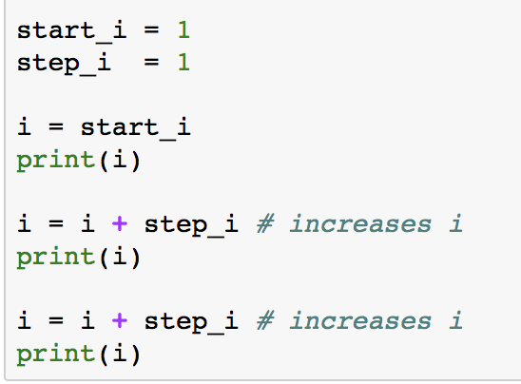

3.1. Using for Loops to Create Number Sequences
Access Jupyter notebook through the terminal: by typing in it: jupyter notebook, click enter and navigate the raspberry directory system as follows: /pi/AOLME/Session 3/
And open the file named: Session 3-Loops
2. Run & Analyze: In CELLs A, B, and C there are some codes, pay attention to the codes in each cell and run them. What happens when you run each CELL? When you change some of the numbers in the code and run it, what happens?
In CELL B, what if you changed step_i value to 5?
Once in this file, note that under title of activity 3.1. there are 3 CELLS: A, B, C
What differences do you notice between CELLS C and A & B?
Use comments in the CELLs as a guide.
3. Think & Create: Now it’s your time to show what you’ve learned. In PRACTICE CELLs A, B, and C type in the codes and run them to see how you are completing the challenge. Sometimes a little typo can be an issue for the code not to run,
4. Discuss & Write: Based on the tasks you’ve done, discuss in your team: What is a for loop?.
Analyze the for loop statement below that we used. What parts of the statement could be changed and what parts of words
for i in range(start_i, stop_i, step_i):
When the codes are entered in without typos or errors and are typed in the right order, then your code syntax is good and will run well.
Write down in your journal what you learned?
AOLME PROJECT - LEVEL 1- SESSION 3- 2018
MATERIALS DEVELOPED BY THE AOLME PROJECT AT THE UNIVERSITY OF NEW MEXICO, PLEASE DO NOT COPY OR DISTRIBUTE ANY OF THESE COPYRIGHTED TASKS WITHOUT PROPER AUTHORIZATION OF PROJECT
Notes:
Reduce number of codes P
Provide examples of images and how they were pixelated

Slide 6

3.1. Exploring Loops & Conditionals
Resources for the Activity
Recommended Steps for the Activity
Activity Card
Folder: /pi/AOLME/Session 2/
the “Jupyter” notebook accessed via Terminal
Raspberry Pi and Monitor
Student journal
Make sure that for the first task students open the ‘Untitled’ file in Session 2 folder. Have them type and try all icons in taskbar. Have them explore and then talk about what the discover. They might make connections to what they’ve done in other computers.
Have students realize different types of cells.
When playing guessing game, let students take turns playing game, maybe by pairs? Taking turns typing?
Task 3 it’s important to notice ‘print’ and what if they didn’t typed print? What happens? Let them experiment.
Have students debrief what they learned by experimenting and have them write notes in journal.
Everyone in the team gets to play a role:
Discussion Expert: Leads the team discussion asking questions about what the session is about.
Fair Participation Expert: makes sure of fair participation of everyone.
Hardware Setup/Teardown Expert: in charge of setting up & putting away materials and computer equipment.
Summary Expert: summarizes and records team questions and what the teams has learned.
Activity 1 Goal: Apply basics of Python Programming.
AOLME PROJECT - LEVEL 1- SESSION 3- 2018
MATERIALS DEVELOPED BY THE AOLME PROJECT AT THE UNIVERSITY OF NEW MEXICO, PLEASE DO NOT COPY OR DISTRIBUTE ANY OF THESE COPYRIGHTED TASKS WITHOUT PROPER AUTHORIZATION OF PROJECT
Notes:
Reduce number of codes P
Provide examples of images and how they were pixelated

Slide 7


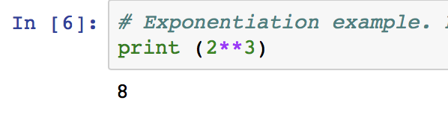
3.2. Combining Loops & Conditionals
1. Let’s use Math and Algebra to program with Python.
2. In TASK 4 in Jupyter, program and operate equations.
What do we remember about linear equations?
Play w/ these equations. Come up with other values. What happens?
What variables do you see?
What’s a variable?
How are these ‘x’ and ‘y’ different from the ‘x’ and ‘y’ of an image coordinate?
3. What do you know about PEMDAS? How can order help?
4. Complete rest of tasks in section 2.2. In task 4, think of variables and PEMDAS. How would you group these numbers?
What do you think about doing Math with Python?
We’re almost ready to program the guessing game!
When running the first cell in Task 3, why do you get two 10s? Change the variable values or operations to get different numbers.
AOLME PROJECT - LEVEL 1- SESSION 3- 2018
MATERIALS DEVELOPED BY THE AOLME PROJECT AT THE UNIVERSITY OF NEW MEXICO, PLEASE DO NOT COPY OR DISTRIBUTE ANY OF THESE COPYRIGHTED TASKS WITHOUT PROPER AUTHORIZATION OF PROJECT

Slide 8
3.2. Combining Loops & Conditionals
Resources for the Activity
Recommended steps for the Activity
Make sure that students understand that variables can be determined in many way. Have them identify and talk about them every time they define them
When running each cell, make sure to have them predict and then try to identify what each code lines does. Perhaps changing numbers can help figure out better what the codes do.
Discuss how the order of operations, grouping and definitions of variables might help solving a problem.
Activity Card
the “Jupyter” notebook accessed via Terminal
Folder: /pi/AOLME/Session 2/
Raspberry Pi and Monitor
Student journal
Activity 2 Goal 1: Program basic operations and variables in Python. Goal 2: Solve and create own operations, and arithmetic-algebraic expressions.
AOLME PROJECT - LEVEL 1- SESSION 3- 2018
MATERIALS DEVELOPED BY THE AOLME PROJECT AT THE UNIVERSITY OF NEW MEXICO, PLEASE DO NOT COPY OR DISTRIBUTE ANY OF THESE COPYRIGHTED TASKS WITHOUT PROPER AUTHORIZATION OF PROJECT
Notes:
Reduce number of codes P
Provide examples of images and how they were pixelated

Slide 9


3.3. Moving AOLME Sprite with Python IDLE
2. Inverse Operations: Multiplication is the inverse of division
Consider the following for a game:
Give me a number x
Multiply by 2. 2*x
Divide by 2. (2*x)/2=x
After these steps, we are back to x. We "divide by 2" because it is the inverse and it helps get rid of the result from "multiply by 2". Why do we want to get rid of the values we enter?
What’s the inverse operation of addition? Why?
The Number Guessing Game. To make the game work, we need to think about inverse operations.
Why do you think we need inverse operations in the number guessing game?
3. Think: What would this game do?
Give me a number. x
Add 3. x+3
Subtract 3. (x+3)-3=x
4. Design and program in your team a number guessing game. Take turns typing in the codes. Save your work. Use the code in cell 2.3. to start your game. Then, try to see if someone not from your group can play your game.
What would be some values or numbers to combine in the guessing game?
Use paper to check and predict whether your game will work.
Write in journal ideas you learned in Session 2 about Python programming.
AOLME PROJECT - LEVEL 1- SESSION 3- 2018
MATERIALS DEVELOPED BY THE AOLME PROJECT AT THE UNIVERSITY OF NEW MEXICO, PLEASE DO NOT COPY OR DISTRIBUTE ANY OF THESE COPYRIGHTED TASKS WITHOUT PROPER AUTHORIZATION OF PROJECT

Slide 10
3.3. Moving AOLME Sprite with Python IDLE
Resources for the Activity
Recommended steps for the Activity
Have students reflect on how numbers cancel each other through inverse operations.
Have them practice on paper getting rid of numbers to ’guess’ the number.
Let students collaborate and have fun and encourage creativity and communication
Try not to tell them, instead ask questions to prompt their thinking.
Invite members from other teams to play the game of your team.
Activity Card
Folder: /home/pi/AOLME/Session2
the “Jupyter” notebook accessed via Terminal
Raspberry Pi kit
Student journal
Evaluate how did the team roles work?
Discussion Expert: Leads the team discussion asking questions about what the session is about.
Fair Participation Expert: makes sure of fair participation of everyone.
Hardware Setup/Teardown Expert: in charge of setting up & putting away materials and computer equipment.
Summary Expert: summarizes and records team questions and what the teams has learned.
Activity 3 Goal: Program a number guessing game using Python.
AOLME PROJECT - LEVEL 1- SESSION 3- 2018
MATERIALS DEVELOPED BY THE AOLME PROJECT AT THE UNIVERSITY OF NEW MEXICO, PLEASE DO NOT COPY OR DISTRIBUTE ANY OF THESE COPYRIGHTED TASKS WITHOUT PROPER AUTHORIZATION OF PROJECT

